Slide 1
Struts2 Tags & Tiles

Slide 2
Agenda
Control Tags
Data Tags
Form Tags
Form Helper Tags
Ajax Tags
Tiles Integration

Slide 3
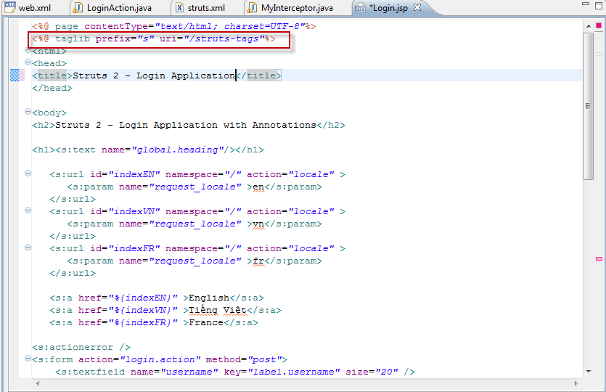
Import tags lib
In JSP pages, must import <%@ taglib prefix="s" uri="/struts-tags"%>
Notes:
<%@ page contentType="text/html; charset=UTF-8"%>
<%@ taglib prefix="s" uri="/struts-tags"%>
<html>
<head>
<title>Struts 2 - Login Application | ViralPatel.net</title>
</head>
<body>
<h2>Struts 2 - Login Application with Annotations</h2>
<h1><s:text name="global.heading"/></h1>
<s:url id="indexEN" namespace="/" action="locale" >
<s:param name="request_locale" >en</s:param>
</s:url>
<s:url id="indexVN" namespace="/" action="locale" >
<s:param name="request_locale" >vn</s:param>
</s:url>
<s:url id="indexFR" namespace="/" action="locale" >
<s:param name="request_locale" >fr</s:param>
</s:url>
<s:a href="%{indexEN}" >English</s:a>
<s:a href="%{indexVN}" >Tiếng Việt</s:a>
<s:a href="%{indexFR}" >France</s:a>
<s:actionerror />
<s:form action="login" method="post">
<s:textfield name="username" key="label.username" size="20" />
<s:password name="password" key="label.password" size="20" />
<s:submit key="label.login" align="center" />
</s:form>
</body>
</html>

Slide 4
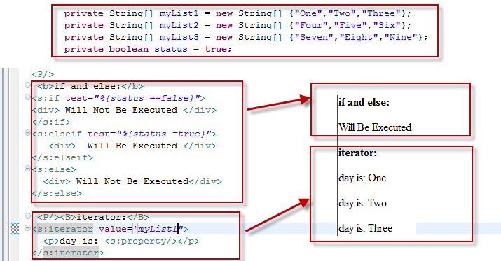
Control Tags
The Struts 2 tags have a set of tags that make it easy to control the flow of page execution.
+ if … else + iterator
+ merge + append + generator
Notes:
if and else:
<s:if test="%{false}">
<div> Will Not Be Executed </div>
</s:if>
<s:elseif test="%{true}">
<div> Will Be Executed </div>
</s:elseif>
<s:else>
<div> Will Not Be Executed</div>
</s:else>
iterator:
<s:iterator value="days">
<p>day is: <s:property/></p>
</s:iterator>

Slide 5
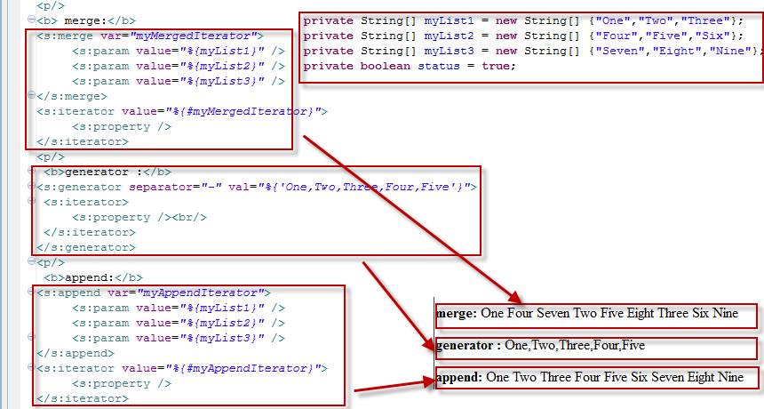
Control Tags
Notes:
merge:
<s:merge var="myMergedIterator">
<s:param value="%{myList1}" />
<s:param value="%{myList2}" />
<s:param value="%{myList3}" />
</s:merge>
<s:iterator value="%{#myMergedIterator}">
<s:property />
</s:iterator>
generator :
<s:generator val="%{'aaa,bbb,ccc,ddd,eee'}">
<s:iterator>
<s:property /><br/>
</s:iterator>
</s:generator>
append:
<s:append var="myAppendIterator">
<s:param value="%{myList1}" />
<s:param value="%{myList2}" />
<s:param value="%{myList3}" />
</s:append>
<s:iterator value="%{#myAppendIterator}">
<s:property />
</s:iterator>

Slide 6
Data Tags
- Are primarily used to manipulate the data displayed on a page.
action
include
bean
date
set
param
text
url
property
push

Slide 7
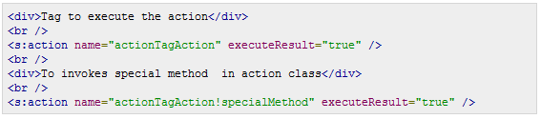


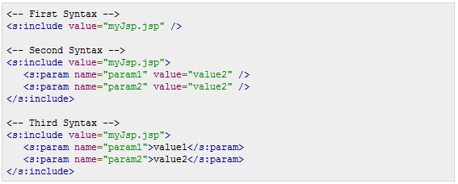
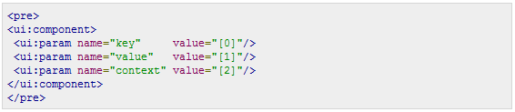
Data Tags
Action Tag: call actions directly from a JSP page
Bean Tag: To instantiate a class that conforms to the JavaBeans specification
Date Tag: will allow you to format a Date in a quick and easy way
Include Tag: Will be used to include a JSP file in another JSP page
Param Tag: Can be used to parameterize other tags
Notes:
Action Tag:
<div>Tag to execute the action</div> <br /> <s:action name="actionTagAction" executeResult="true" /> <br /> <div>To invokes special method in action class</div> <br /> <s:action name="actionTagAction!specialMethod" executeResult="true" />
Include tag:
<-- First Syntax --> <s:include value="myJsp.jsp" /> <-- Second Syntax --> <s:include value="myJsp.jsp"> <s:param name="param1" value="value2" /> <s:param name="param2" value="value2" /> </s:include> <-- Third Syntax --> <s:include value="myJsp.jsp"> <s:param name="param1">value1</s:param> <s:param name="param2">value2</s:param> </s:include>
Bean tag:
<s:bean name="org.apache.struts2.util.Counter" var="counter"> <s:param name="first" value="20"/> <s:param name="last" value="25" /> </s:bean>
<s:date name="person.birthday" format="dd/MM/yyyy" /> <s:date name="person.birthday" format="%{getText('some.i18n.key')}" /> <s:date name="person.birthday" nice="true" /> <s:date name="person.birthday" />
<pre> <ui:component> <ui:param name="key" value="[0]"/> <ui:param name="value" value="[1]"/> <ui:param name="context" value="[2]"/> </ui:component> </pre>
<s:push value="myBean"> <!-- Example 1: --> <s:property value="myBeanProperty" /> <!-- Example 2: -->TextUtils <s:property value="myBeanProperty" default="a default value" /> </s:push>
<s:push value="user"> <s:propery value="firstName" /> <s:propery value="lastName" /> </s:push>
<s:set name="myenv" value="environment.name"/> <s:property value="myenv"/>
<!-- First Example --> <s:i18n name="struts.action.test.i18n.Shop"> <s:text name="main.title"/> </s:i18n> <!-- Second Example --> <s:text name="main.title" /> <!-- Third Examlpe --> <s:text name="i18n.label.greetings"> <s:param >Mr Smith</s:param> </s:text>
<-- Example 1 --> <s:url value="editGadget.action"> <s:param name="id" value="%{selected}" /> </s:url> <-- Example 2 --> <s:url action="editGadget"> <s:param name="id" value="%{selected}" /> </s:url> <-- Example 3--> <s:url includeParams="get"> <s:param name="id" value="%{'22'}" /> </s:url>

Slide 8
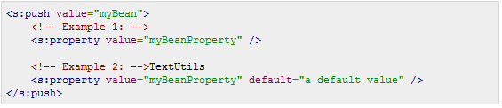
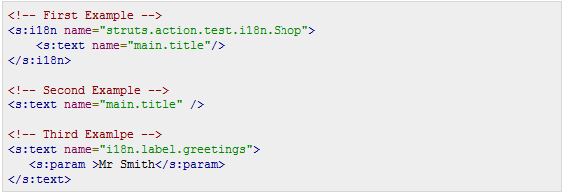

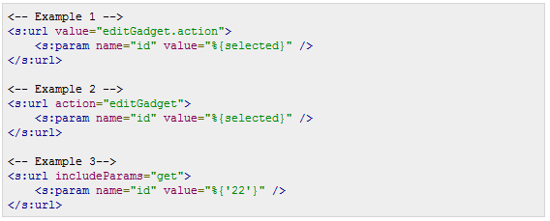
Data Tags
Property Tag: To get the property of a value, which will default to the top of the stack if none is specified.
Text Tag: use to render a I18n text message
Push Tag: To push value on stack for simplified usage
Url Tag: use to create a URL
Set Tag: assigns a value to a variable in a specified scope
Notes:
<s:push value="myBean"> <!-- Example 1: --> <s:property value="myBeanProperty" /> <!-- Example 2: -->TextUtils <s:property value="myBeanProperty" default="a default value" /> </s:push>
<s:push value="user"> <s:propery value="firstName" /> <s:propery value="lastName" /> </s:push>
<s:set name="myenv" value="environment.name"/> <s:property value="myenv"/>
<!-- First Example --> <s:i18n name="struts.action.test.i18n.Shop"> <s:text name="main.title"/> </s:i18n> <!-- Second Example --> <s:text name="main.title" /> <!-- Third Examlpe --> <s:text name="i18n.label.greetings"> <s:param >Mr Smith</s:param> </s:text>
<-- Example 1 --> <s:url value="editGadget.action"> <s:param name="id" value="%{selected}" /> </s:url> <-- Example 2 --> <s:url action="editGadget"> <s:param name="id" value="%{selected}" /> </s:url> <-- Example 3--> <s:url includeParams="get"> <s:param name="id" value="%{'22'}" /> </s:url>

Slide 9
The Form Tags
To help in the rendering of the user interface required for the Struts web applications and can be categorized into three categories.
Autocomplete
Checkbox
Checkboxlist
Combobox
Datetimepicker
Doubleselect
Head
File
Form
hidden
Label
Optiontransferselect
Optiongroup
Password
Radio
Select
Submit
Textarea
Textfield
Token
updownselector

Slide 10
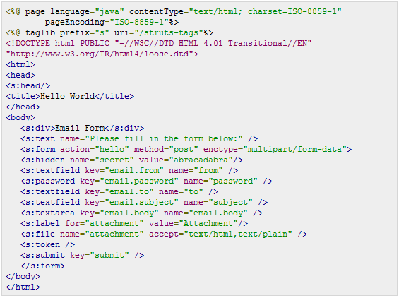
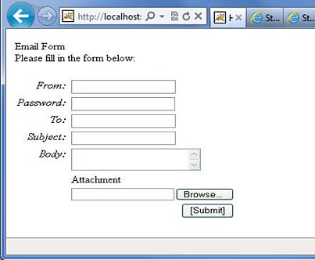
The Form Tags Example
Notes:
<%@ page language="java" contentType="text/html; charset=ISO-8859-1"
pageEncoding="ISO-8859-1"%>
<%@ taglib prefix="s" uri="/struts-tags"%>
<!DOCTYPE html PUBLIC "-//W3C//DTD HTML 4.01 Transitional//EN"
"http://www.w3.org/TR/html4/loose.dtd">
<html>
<head>
<s:head/>
<title>Hello World</title>
</head>
<body>
<s:div>Email Form</s:div>
<s:text name="Please fill in the form below:" />
<s:form action="hello" method="post" enctype="multipart/form-data">
<s:hidden name="secret" value="abracadabra"/>
<s:textfield key="email.from" name="from" />
<s:password key="email.password" name="password" />
<s:textfield key="email.to" name="to" />
<s:textfield key="email.subject" name="subject" />
<s:textarea key="email.body" name="email.body" />
<s:label for="attachment" value="Attachment"/>
<s:file name="attachment" accept="text/html,text/plain" />
<s:token />
<s:submit key="submit" />
</s:form>
</body>
</html>

Slide 11
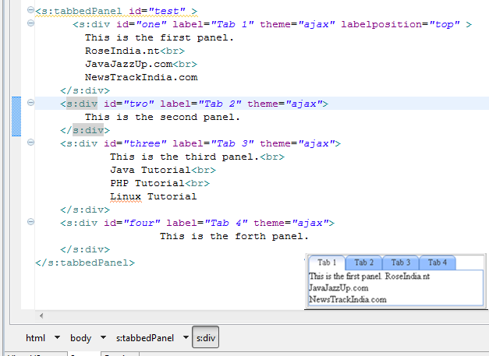
Form Helper Tags
actionerror
actionMessage
compact
div
fieldError
table
tabbedPanel
tree
treenode
Notes:
<s:tabbedPanel id="test" > <s:div id="one" label="Tab 1" theme="ajax" labelposition="top" > This is the first panel. RoseIndia.nt<br> JavaJazzUp.com<br> NewsTrackIndia.com </s:div> <s:div id="two" label="Tab 2" theme="ajax"> This is the second panel. </s:div> <s:div id="three" label="Tab 3" theme="ajax"> This is the third panel.<br> Java Tutorial<br> PHP Tutorial<br> Linux Tutorial </s:div> <s:div id="four" label="Tab 4" theme="ajax"> This is the forth panel. </s:div> </s:tabbedPanel>

Slide 12
Tiles Integration

Slide 13
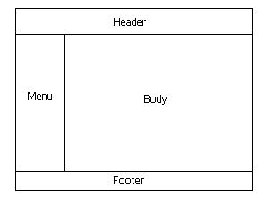
Tiles Overview
- Tiles is a template framework built to simplify the development of web application user interfaces.
- Define a "baseLayout" that contains a title, header, menu, body and footer regions.
- The header, menu and footer region remains the same for all the layouts only the title and body content changes.

Slide 14
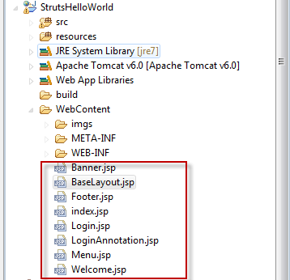
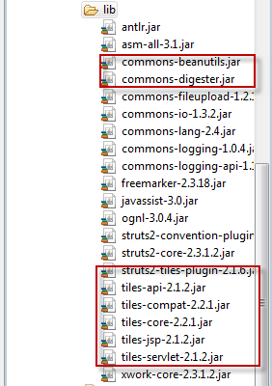
Jar Libs & JSP files
Create 5 JSP pages: BaseLayout.jsp, Banner.jsp, Menu.jsp, Footer.jsp, index.jsp
Add 8 .jar files into lib:

Slide 15
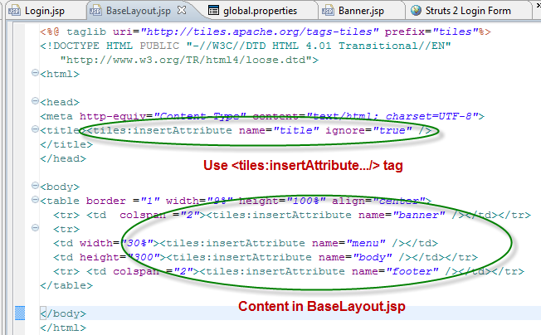
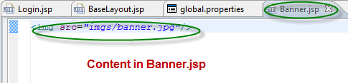
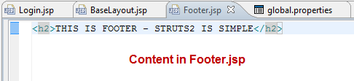
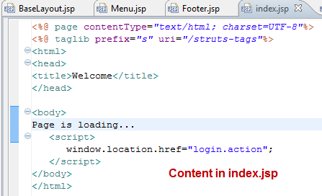
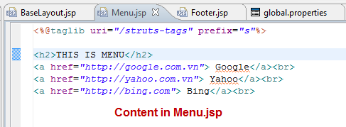
Jar Libs & JSP files
Notes:
<!– banner→
<img src="imgs/banner.jpg"/>
<!—BaseLayout→
<%@ taglib uri="http://tiles.apache.org/tags-tiles" prefix="tiles"%>
<!DOCTYPE HTML PUBLIC "-//W3C//DTD HTML 4.01 Transitional//EN"
"http://www.w3.org/TR/html4/loose.dtd">
<html>
<head>
<meta http-equiv="Content-Type" content="text/html; charset=UTF-8">
<title><tiles:insertAttribute name="title" ignore="true" />
</title>
</head>
<body>
<table border ="1" width="9%" height="100%" align="center">
<tr> <td colspan ="2"><tiles:insertAttribute name="banner" /></td></tr>
<tr>
<td width="30%"><tiles:insertAttribute name="menu" /></td>
<td height="300"><tiles:insertAttribute name="body" /></td></tr>
<tr> <td colspan ="2"><tiles:insertAttribute name="footer" /></td></tr>
</table>
</body>
</html>
<!--- MENU→
<%@taglib uri="/struts-tags" prefix="s"%>
<h2>THIS IS MENU</h2>
<a href="http://google.com.vn"> Google</a><br>
<a href="http://yahoo.com.vn"> Yahoo</a><br>
<a href="http://bing.com"> Bing</a><br>
<!– Footet→
<h2>THIS IS FOOTER - STRUTS2 IS SIMPLE</h2>
<!– index→
<%@ page contentType="text/html; charset=UTF-8"%>
<%@ taglib prefix="s" uri="/struts-tags"%>
<html>
<head>
<title>Welcome</title>
</head>
<body>
Page is loading...
<script>
window.location.href="login.action";
</script>
</body>
</html>

Slide 16
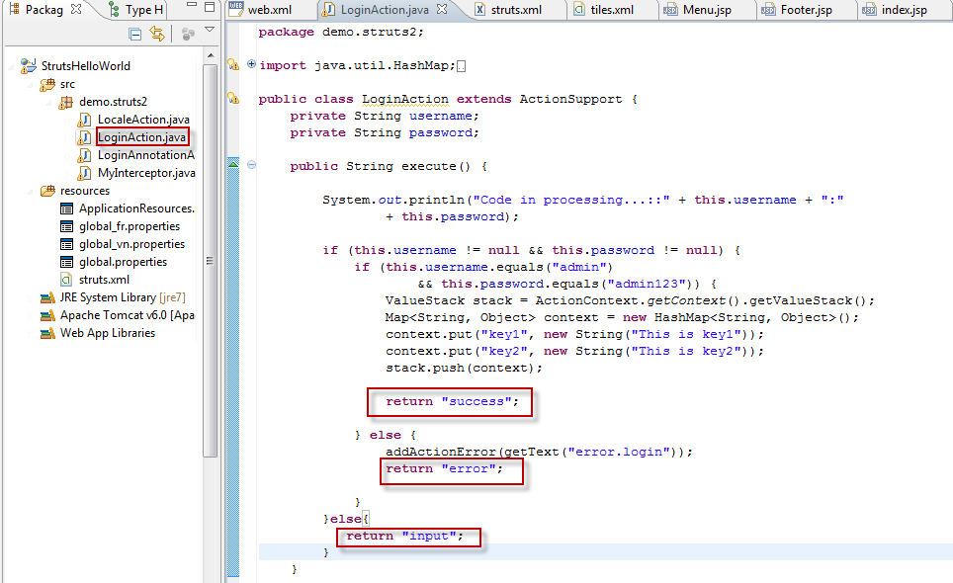
LoginAction
Implement code in LoginAction.java
Notes:
package demo.struts2;
import java.util.HashMap;
import java.util.Map;
import com.opensymphony.xwork2.ActionContext;
import com.opensymphony.xwork2.ActionSupport;
import com.opensymphony.xwork2.util.ValueStack;
import org.apache.tiles.impl.BasicTilesContainer;
public class LoginAction extends ActionSupport {
private String username;
private String password;
public String execute() {
System.out.println("Code in processing...::" + this.username + ":"
+ this.password);
if (this.username != null && this.password != null) {
if (this.username.equals("admin")
&& this.password.equals("admin123")) {
ValueStack stack = ActionContext.getContext().getValueStack();
Map<String, Object> context = new HashMap<String, Object>();
context.put("key1", new String("This is key1"));
context.put("key2", new String("This is key2"));
stack.push(context);
return "success";
} else {
addActionError(getText("error.login"));
return "error";
}
}else{
return "input";
}
}
public void validate() {
if (username == null || username.trim().equals("")) {
addFieldError("username", "The name is required");
}
if (password == null || password.trim().equals("")) {
addFieldError("password", "The password is required");
}
}
public String getUsername() {
return username;
}
public void setUsername(String username) {
this.username = username;
}
public String getPassword() {
return password;
}
public void setPassword(String password) {
this.password = password;
}
}

Slide 17
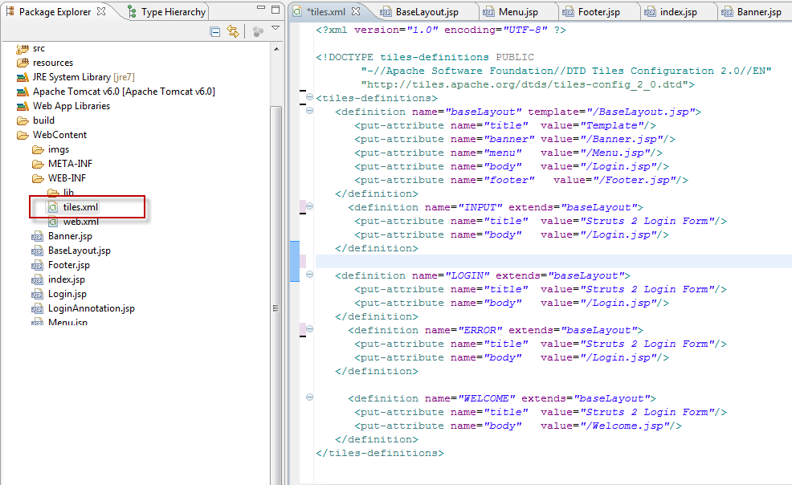
Tiles.xml
Create tiles.xml under /WEB-INF folder an definition name, attribute with the following contents:
Notes:
<?xml version="1.0" encoding="UTF-8" ?>
<!DOCTYPE tiles-definitions PUBLIC
"-//Apache Software Foundation//DTD Tiles Configuration 2.0//EN"
"http://tiles.apache.org/dtds/tiles-config_2_0.dtd">
<tiles-definitions>
<definition name="baseLayout" template="/BaseLayout.jsp">
<put-attribute name="title" value="Template"/>
<put-attribute name="banner" value="/Banner.jsp"/>
<put-attribute name="menu" value="/Menu.jsp"/>
<put-attribute name="body" value="/Login.jsp"/>
<put-attribute name="footer" value="/Footer.jsp"/>
</definition>
<definition name="INPUT" extends="baseLayout">
<put-attribute name="title" value="Struts 2 Login Form"/>
<put-attribute name="body" value="/Login.jsp"/>
</definition>
<definition name="LOGIN" extends="baseLayout">
<put-attribute name="title" value="Struts 2 Login Form"/>
<put-attribute name="body" value="/Login.jsp"/>
</definition>
<definition name="ERROR" extends="baseLayout">
<put-attribute name="title" value="Struts 2 Login Form"/>
<put-attribute name="body" value="/Login.jsp"/>
</definition>
<definition name="WELCOME" extends="baseLayout">
<put-attribute name="title" value="Struts 2 Login Form"/>
<put-attribute name="body" value="/Welcome.jsp"/>
</definition>
</tiles-definitions>

Slide 18
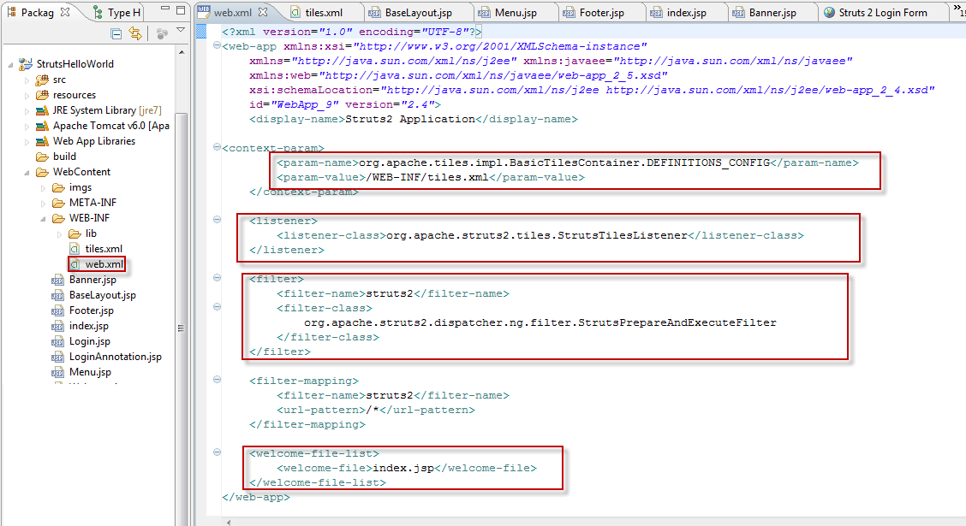
web.xml configuration
Use BasicTilesContainer, StrutsTileListener, StrutsPrepareAndExecuteFilter
Notes:
<?xml version="1.0" encoding="UTF-8"?>
<web-app xmlns:xsi="http://www.w3.org/2001/XMLSchema-instance"
xmlns="http://java.sun.com/xml/ns/j2ee" xmlns:javaee="http://java.sun.com/xml/ns/javaee"
xmlns:web="http://java.sun.com/xml/ns/javaee/web-app_2_5.xsd"
xsi:schemaLocation="http://java.sun.com/xml/ns/j2ee http://java.sun.com/xml/ns/j2ee/web-app_2_4.xsd"
id="WebApp_9" version="2.4">
<display-name>Struts2 Application</display-name>
<context-param>
<param-name>org.apache.tiles.impl.BasicTilesContainer.DEFINITIONS_CONFIG</param-name>
<param-value>/WEB-INF/tiles.xml</param-value>
</context-param>
<listener>
<listener-class>org.apache.struts2.tiles.StrutsTilesListener</listener-class>
</listener>
<filter>
<filter-name>struts2</filter-name>
<filter-class>
org.apache.struts2.dispatcher.ng.filter.StrutsPrepareAndExecuteFilter
</filter-class>
</filter>
<filter-mapping>
<filter-name>struts2</filter-name>
<url-pattern>/*</url-pattern>
</filter-mapping>
<welcome-file-list>
<welcome-file>index.jsp</welcome-file>
</welcome-file-list>
</web-app>

Slide 19
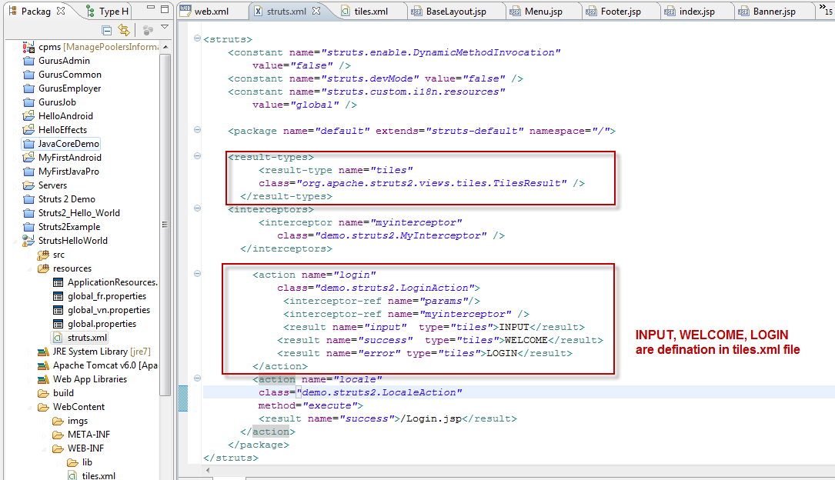
struts.xml configuration
Use TilesResult, for each result instead of forwarding to the jsp page forward it to the tiles definition.
Notes:
<?xml version="1.0" encoding="UTF-8" ?>
<!DOCTYPE struts PUBLIC
"-//Apache Software Foundation//DTD Struts Configuration 2.0//EN"
"http://struts.apache.org/dtds/struts-2.0.dtd">
<struts>
<constant name="struts.enable.DynamicMethodInvocation"
value="false" />
<constant name="struts.devMode" value="false" />
<constant name="struts.custom.i18n.resources"
value="global" />
<package name="default" extends="struts-default" namespace="/">
<result-types>
<result-type name="tiles"
class="org.apache.struts2.views.tiles.TilesResult" />
</result-types>
<interceptors>
<interceptor name="myinterceptor"
class="demo.struts2.MyInterceptor" />
</interceptors>
<action name="login"
class="demo.struts2.LoginAction">
<interceptor-ref name="params"/>
<interceptor-ref name="myinterceptor" />
<result name="input" type="tiles">INPUT</result>
<result name="success" type="tiles">WELCOME</result>
<result name="error" type="tiles">LOGIN</result>
</action>
<action name="locale"
class="demo.struts2.LocaleAction"
method="execute">
<result name="success">/Login.jsp</result>
</action>
</package>
</struts>

Slide 20
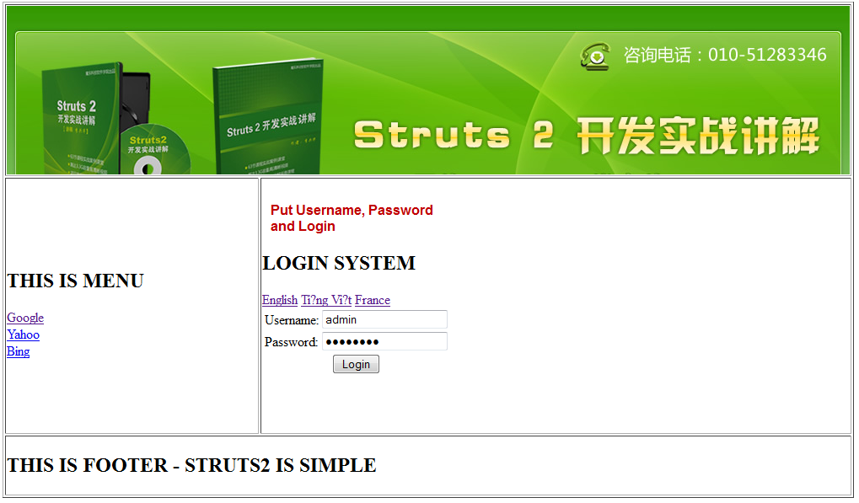
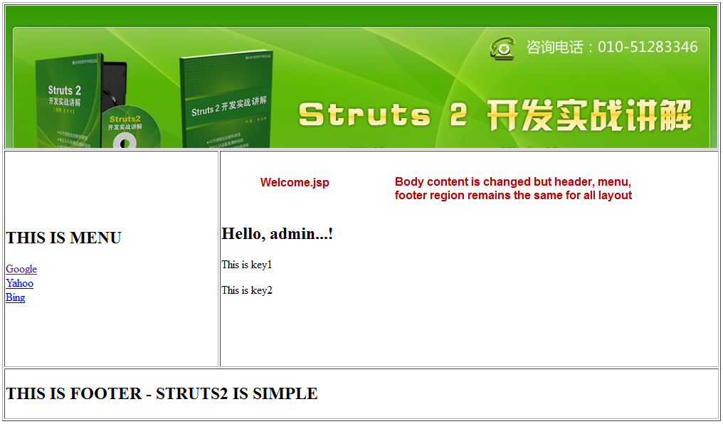
Run & view
Login.jsp, Welcome.jsp extends BaseLayout.jsp
Content in page body is changed but header, menu, footer region remains the same for all.

Slide 21
Summary
Use Control tags to control the flow of page execution
Use Data tags to manipulate the data displayed on a page
Use Form tags to help in the rendering of the user interface required
Use Help tags: actionerror, actionMessage, compact, fieldError, table, tabbedPanel to support validate() method for showing message
Use DOJO framework for the AJAX tag implementation
Use Struts Tiles as a template to apply all pages.

Slide 22
Q & A

